Slide 1


Software Choices:
Lab 1

Slide 2
Agenda
Why write code?
Choosing a programming language
What is “data”?
You are not alone (how to find help)
Overview of the RStudio environment
R programming basics and best practices

Slide 3
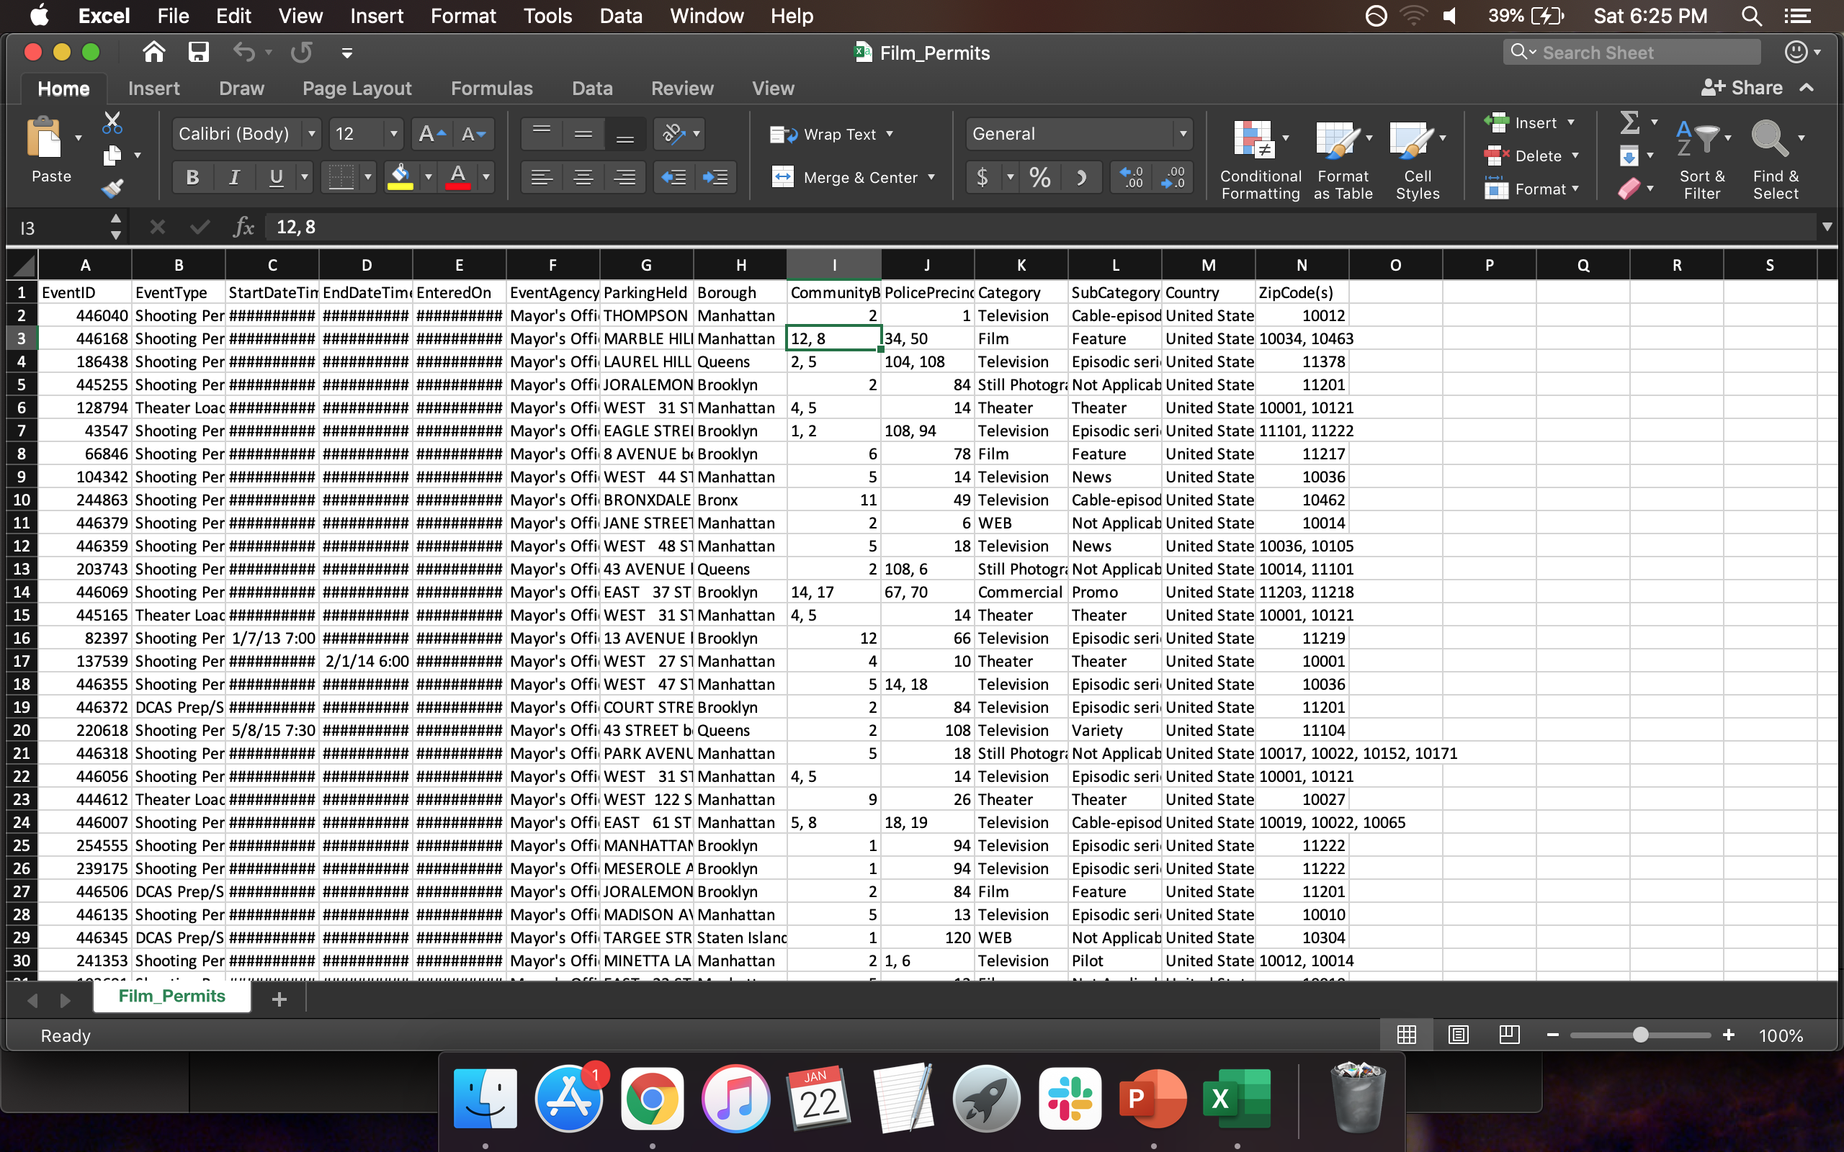
Why programming? Why not use Excel?
… 64,000 more rows
“90% of data ever created was in the last 2 years”

Slide 4
Why programming? Why not use Excel?
Most tasks are too labor-intensive to do by hand
Humans are prone to making mistakes
Programs are documents of your analysis pipeline

Slide 5
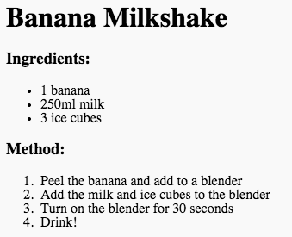
Enter programming/scripting languages
Python
R
MATLAB
Julia
Java
SQL
Scala
SAS
Lua
Perl
PHP
C
C#
C++
Ruby

Slide 6

R versus Python

Slide 7

R and Python
Both are useful, and worth your time exploring
There’s nothing one can do that the other can’t
Core programming concepts are same, main differences are:
Syntax
Community conventions
Package availability
Learning one will ease learning others

Slide 8
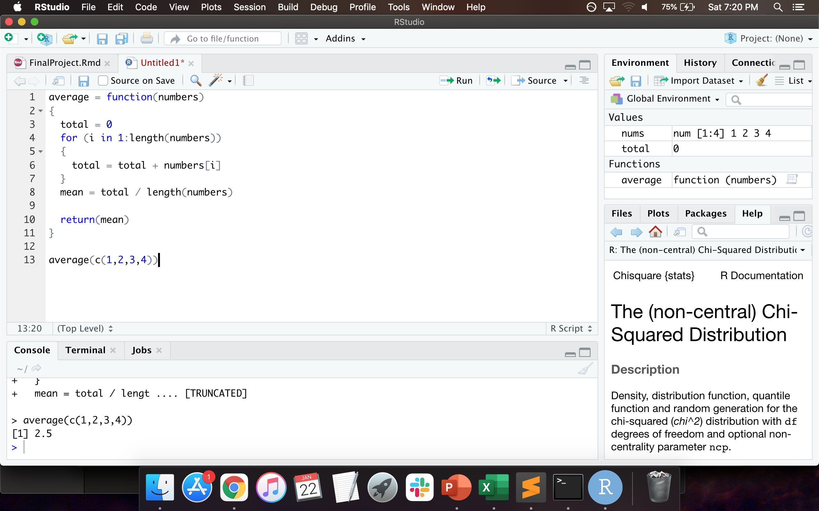
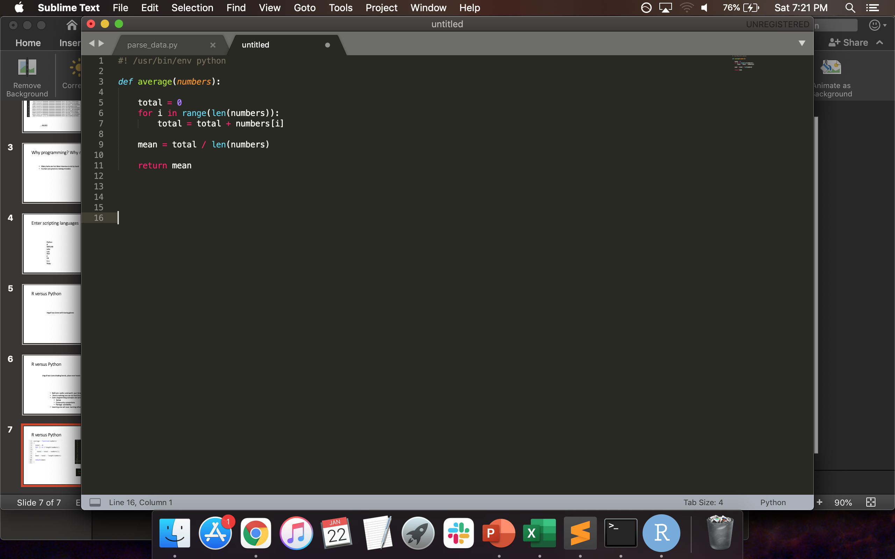
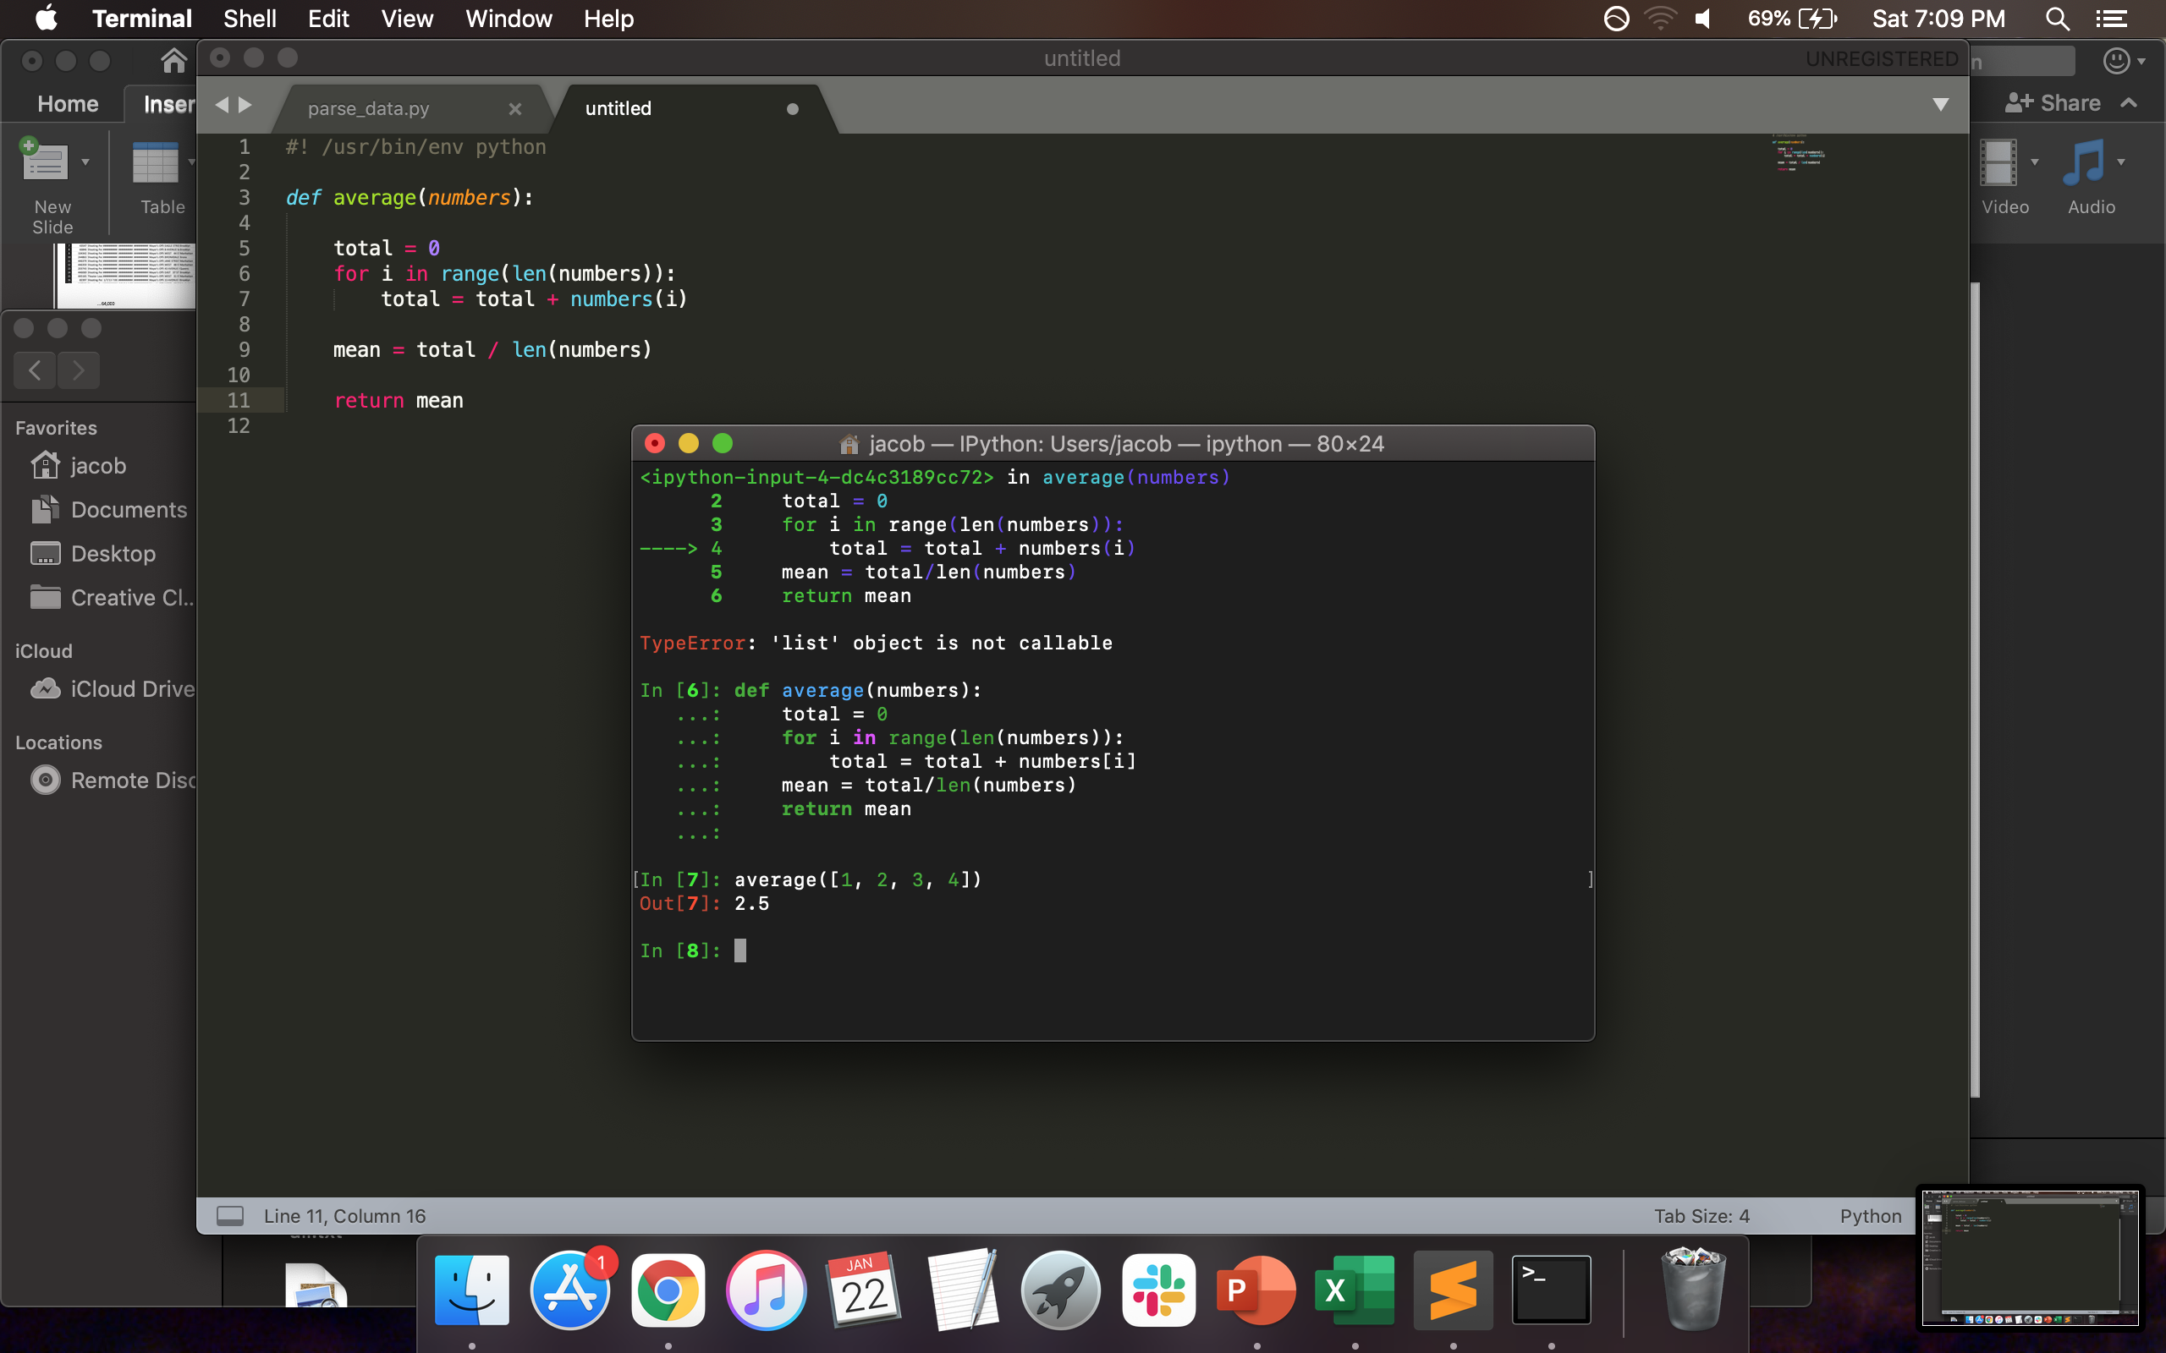
R versus Python

Slide 9




Where to find data

Slide 10
Data organization
columns (variables)
rows

Slide 11
Common data formats
.txt
.bin
.csv
.tsv
.html
.jpg, .png, .tiff, .bmp
.wav
.json
.dat

Slide 12
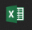

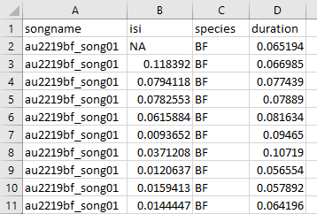
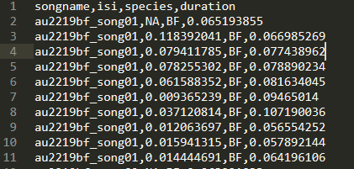
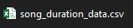
Common data formats

Slide 13
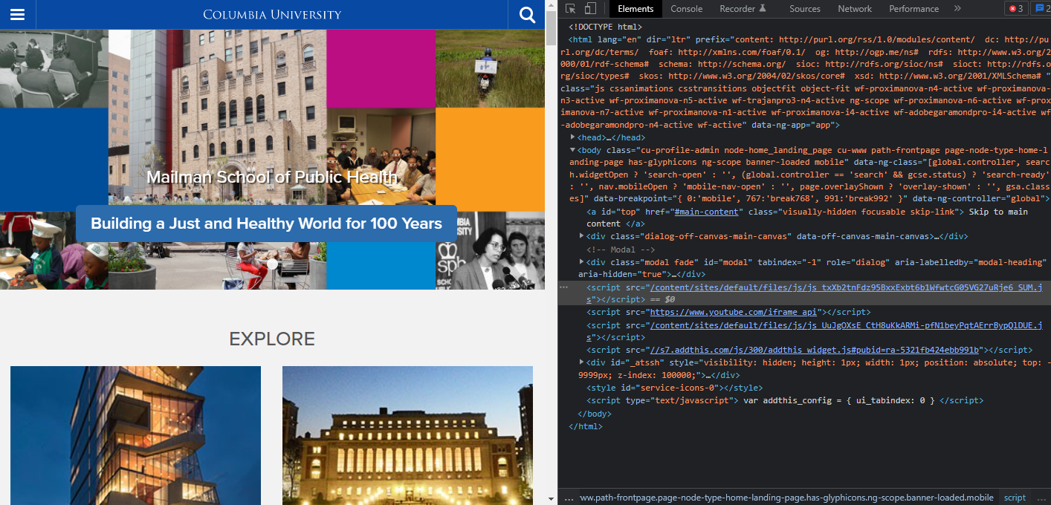
Common data formats

Slide 14

Your strongest ally

Slide 15
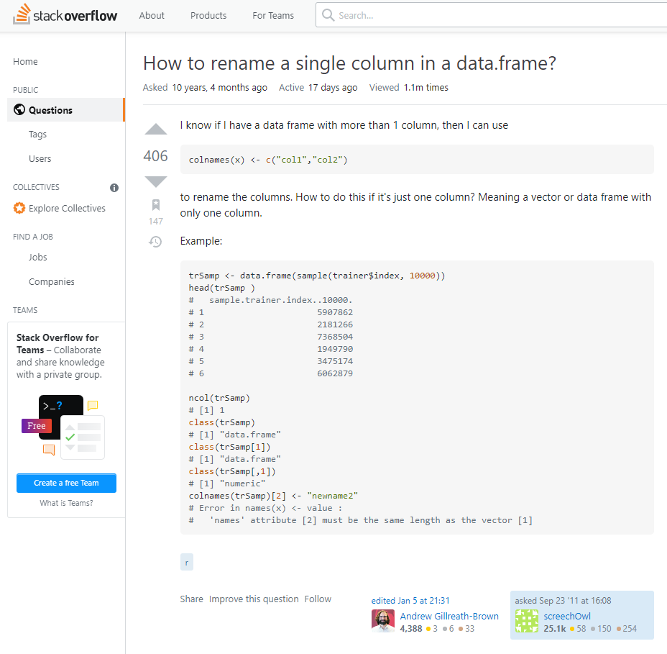
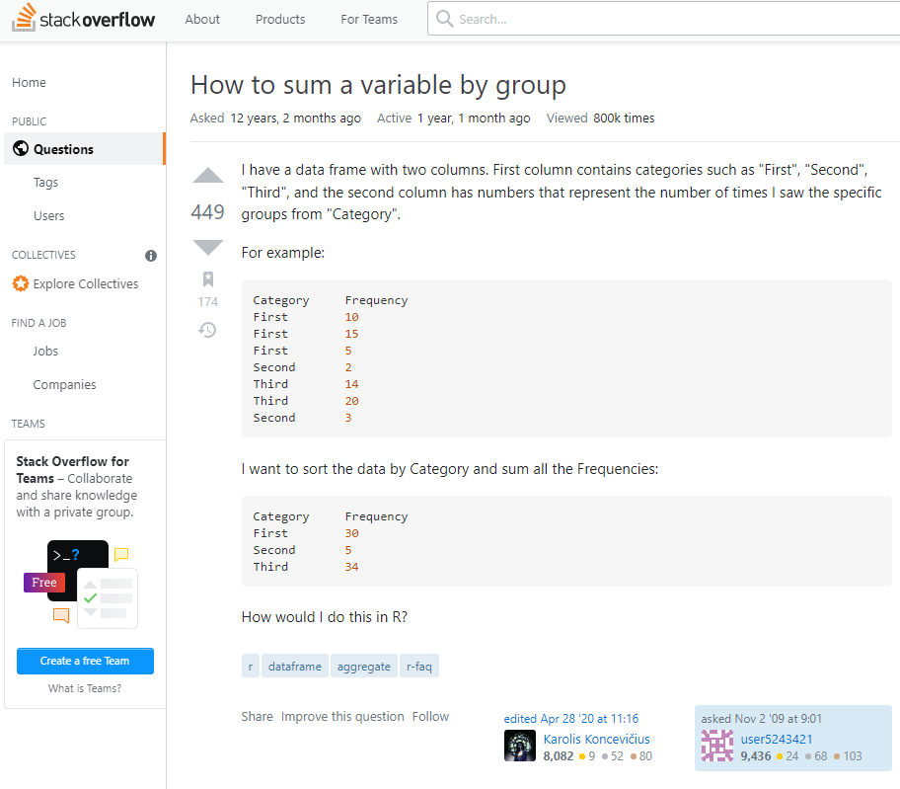
Your strongest ally

Slide 16
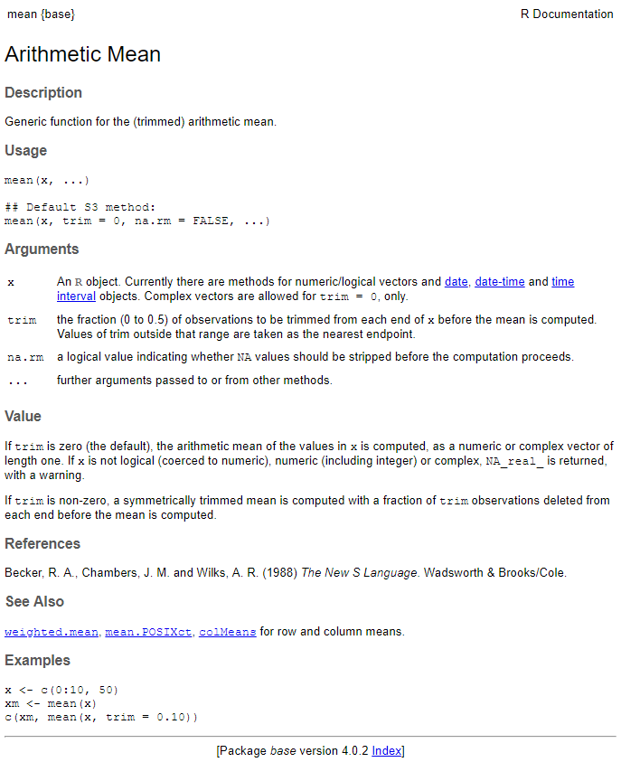
Your second strongest ally – the docs

Slide 17
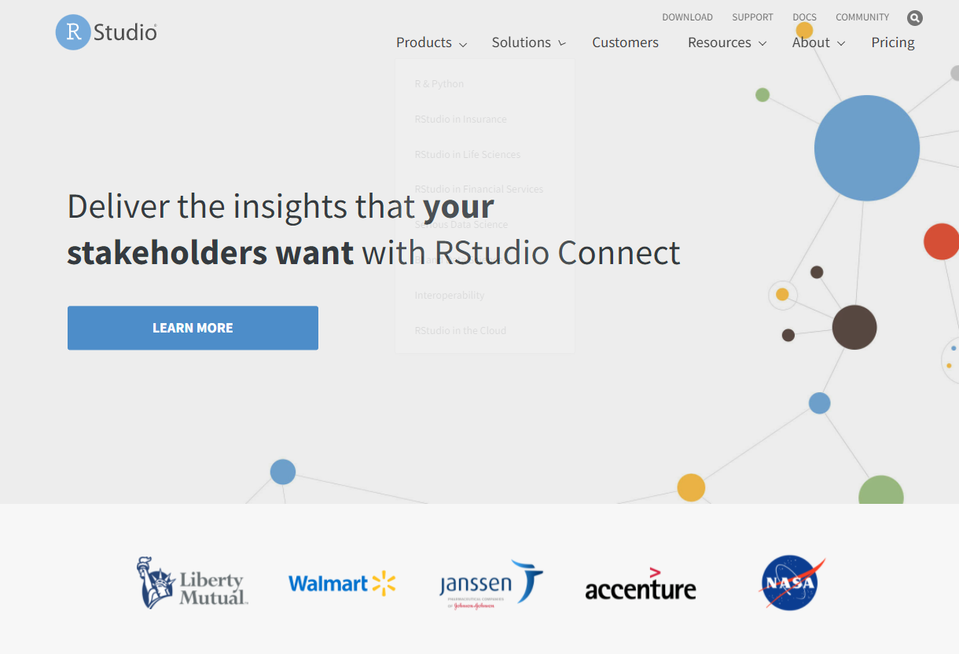
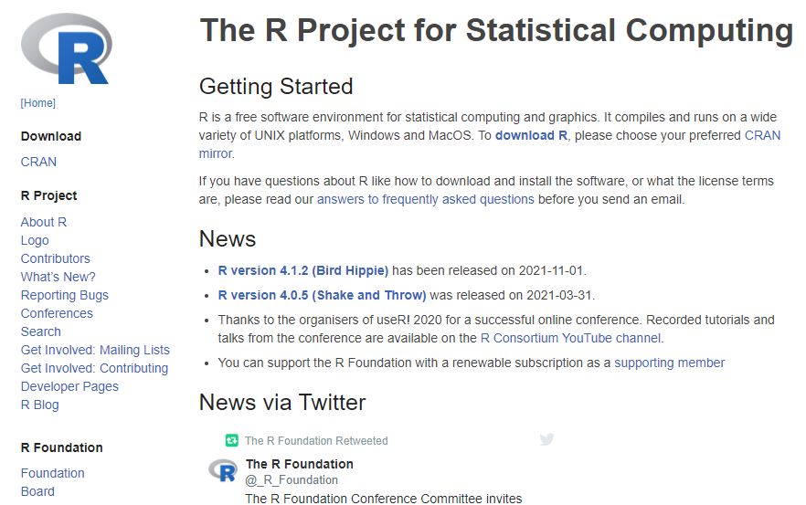
R and RStudio
https://www.r-project.org/
https://www.rstudio.com/

